Slide 1
PANIMALAR ENGINEERING COLLEGE
Department of Computer Science
AI based rectal cancer and stage prediction over web in real-time for general users
Domain:
Artificial intelligence (AI), Web-development
Team Members:
Boggada Mounika, Y. Eesha Sai Sri, Pancheti Divija Reddy
1

Slide 2
Project Overview
With the development of targeted therapies, many treatments are based on molecular studies, which require sampling tumour tissue from paraffin blocks for sequencing. An automated solution could potentially reduce the workload of pathologists by acting as a screening device and may reduce the subjectivity in diagnosis. In tissue-based diagnostics, most of the work still needs to be done manually by a pathologist using a microscope to examine stained slides. The foundation of such tasks is to accurately distinguish cancer/malignant cells from normal/benign cells. However, the determination of tumour content is poorly reproducible with significant variation. As the size of tumour regions can be very small, pathologists are often required to use high magnification for detecting tumour cells. This requirement significantly increases the workload for pathologists. As digital pathology datasets have become publicly available and have opened up the possibility of evaluating the feasibility of applying deep learning techniques to improving the efficiency and quality of histologic diagnosis. In this project we introduce an user facing AI based application to detect and predict the stage of Rectal cancer based on CNN with Attention mechanism and Ranking algorithm.
2

Slide 3
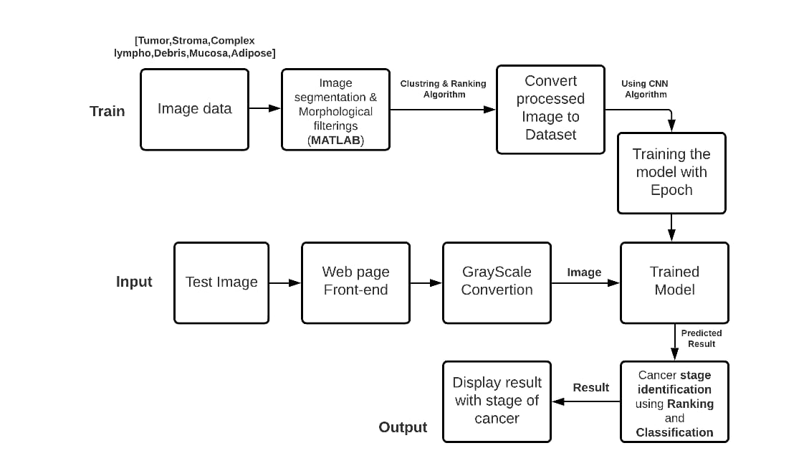
Development Rules / Modules
3

Slide 4
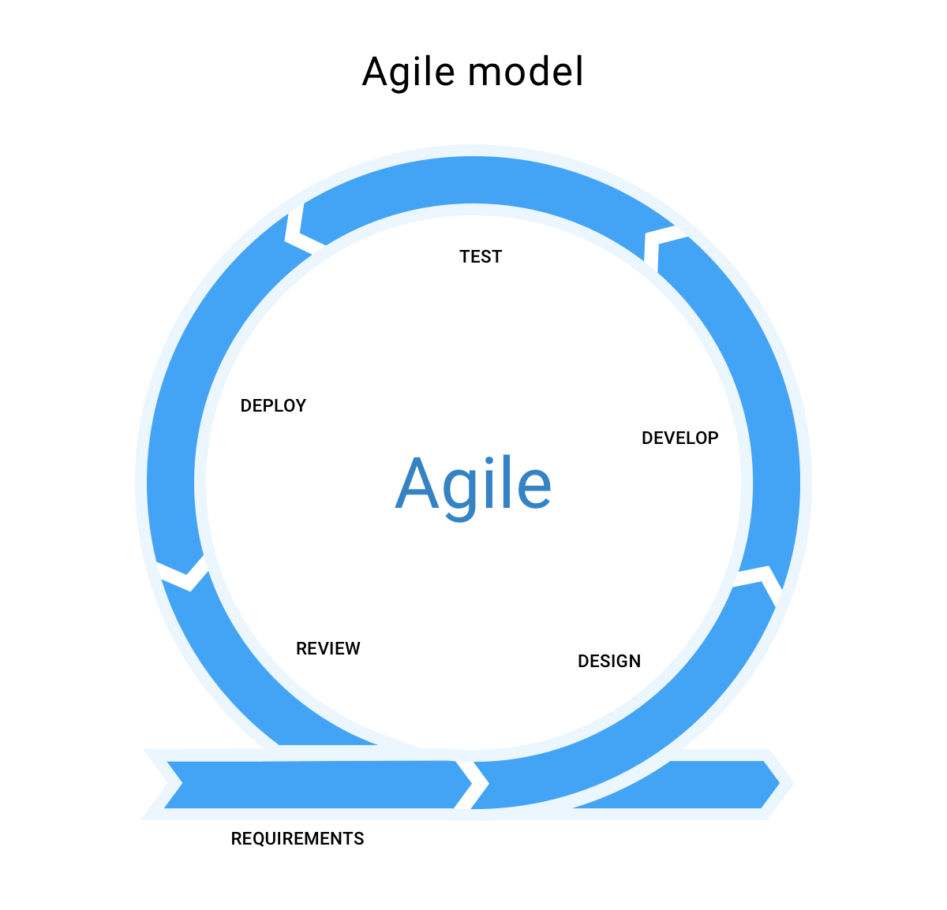
Agile SDLC Model

Slide 5
Project Timeline in Days
Item | Days
Planning | 20
Data collection and training the model for efficiency over Azure ML | 25
Designing UI and configuring Azure VM | 20
Integrating Azure ML with Frontend | 15
Integrating DNS and Hosting the VM | 10
Smoke testing the Module | 10
Performance and load testing | 20
Production Release | 3

Slide 6
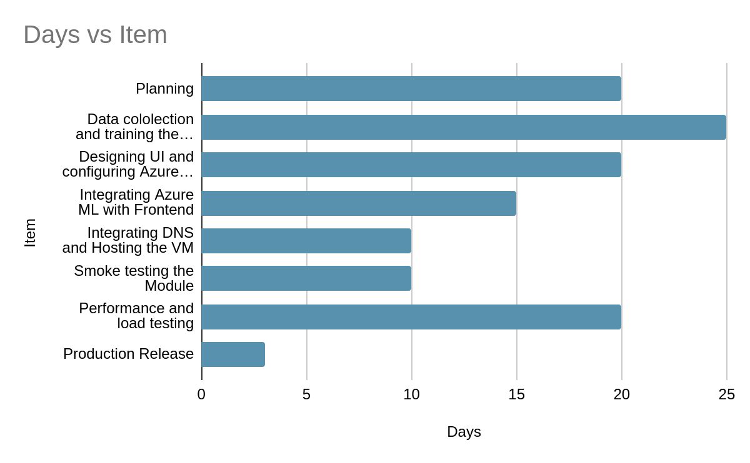

Slide 7
TECHNOLOGY STACK
Convolutional Neural Networks (CNN) with Attention Mechanism + RANKING
Artificial intelligence (AI) ->
Web page
{
Front end
->
Flask + Azure VM
7

Slide 8
Application, use-case and Reference
reduce the workload of pathologists by acting as a screening device and also reduce the subjectivity in diagnosis.
Inclusion of feature in Scanning Devices for Quick analysis
possibility of evaluating the feasibility of applying deep learning techniques to improving the efficiency and quality of histologic diagnosis.
Data set : https://zenodo.org/record/53169#.Yb8SEtvhXEp
Base paper: https://ieeexplore.ieee.org/document/9044355
8

